Slide 1
WEEK-2 ASSIGNMENT
MSDS-610

Slide 2
DATASET DESCRIPTION
Data extracted from Census data of 1994
Dataset Extraction was done by Barry Becker
48842 Instances
14 Features
Source : Link

Slide 3
FEATURE DESCRIPTION
Age- The age of the person
Workclass- The type of employment
Education - The level of study
Education Num - The number of year the person studied
Marital Status - Eg. Married, Single, Divorced

Slide 4
FEATURE DESCRIPTION
Occupation- The work that the person does
Relationship- The relation of the person if married
Race - Eg. Asian, White, Black etc.
Sex- Male , Female
Native Country- Place of origin

Slide 5
FEATURE DESCRIPTION
Capital Gain - The money gained through investments
Capital Loss- The money incurred through investments
Hours Per Week - Number of hours worked in a week
Income - Annual income

Slide 6
DATA TYPE
Workclass
Marital Status
Occupation
Relationship
Sex
Native country
Race
Nominal
Ordinal
Income
Education
Hours worked per Week
Education Number
Capital Gain
Capital Loss
Discreet
Continuous
Age
Fnlwgt

Slide 7
Problem Definition
“Predict whether an individual has the financial
ability to buy a house, during this age of inflation”
Problem Statement - Given dataset that includes features such as age, workclass, occupation, and many other factors, the task here is to find out whether an individual can afford a house.
Relevance
Puts light on the solemn issue of housing affordability
Might help people by targeted intervention for housing
Help assess loan for needy people

Slide 8
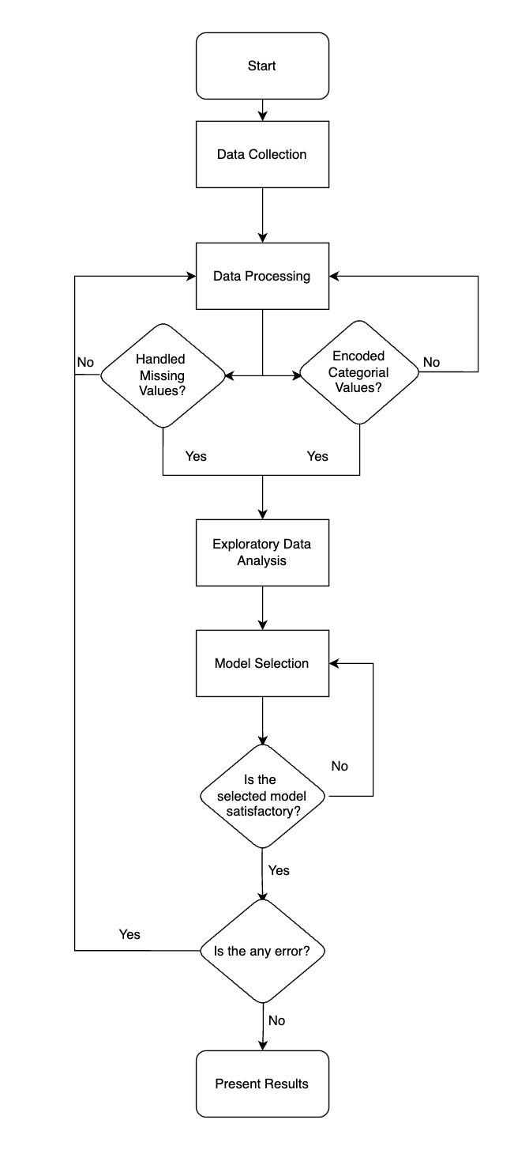
Flowchart
of the
Machine Learning System

Slide 9
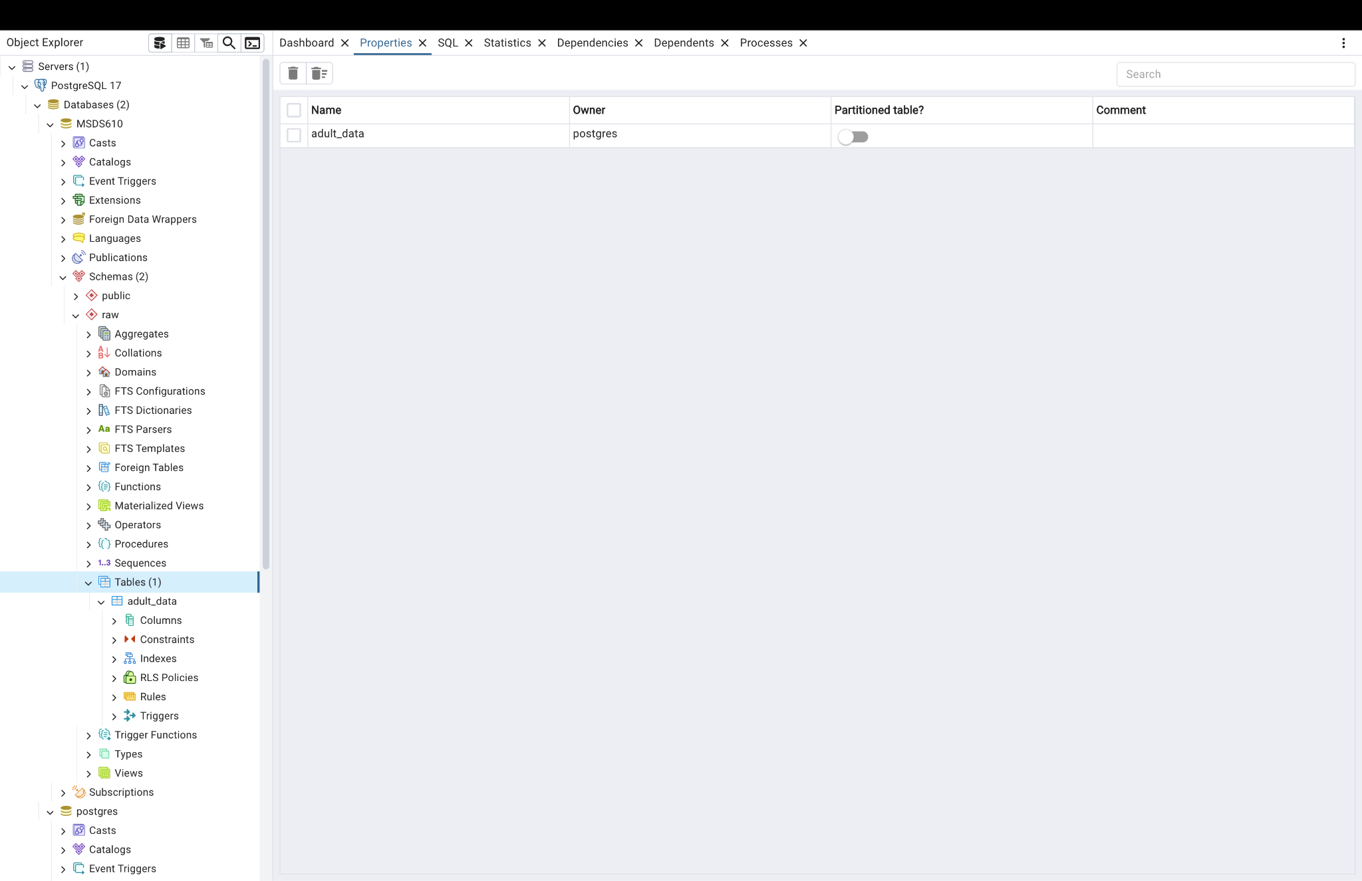
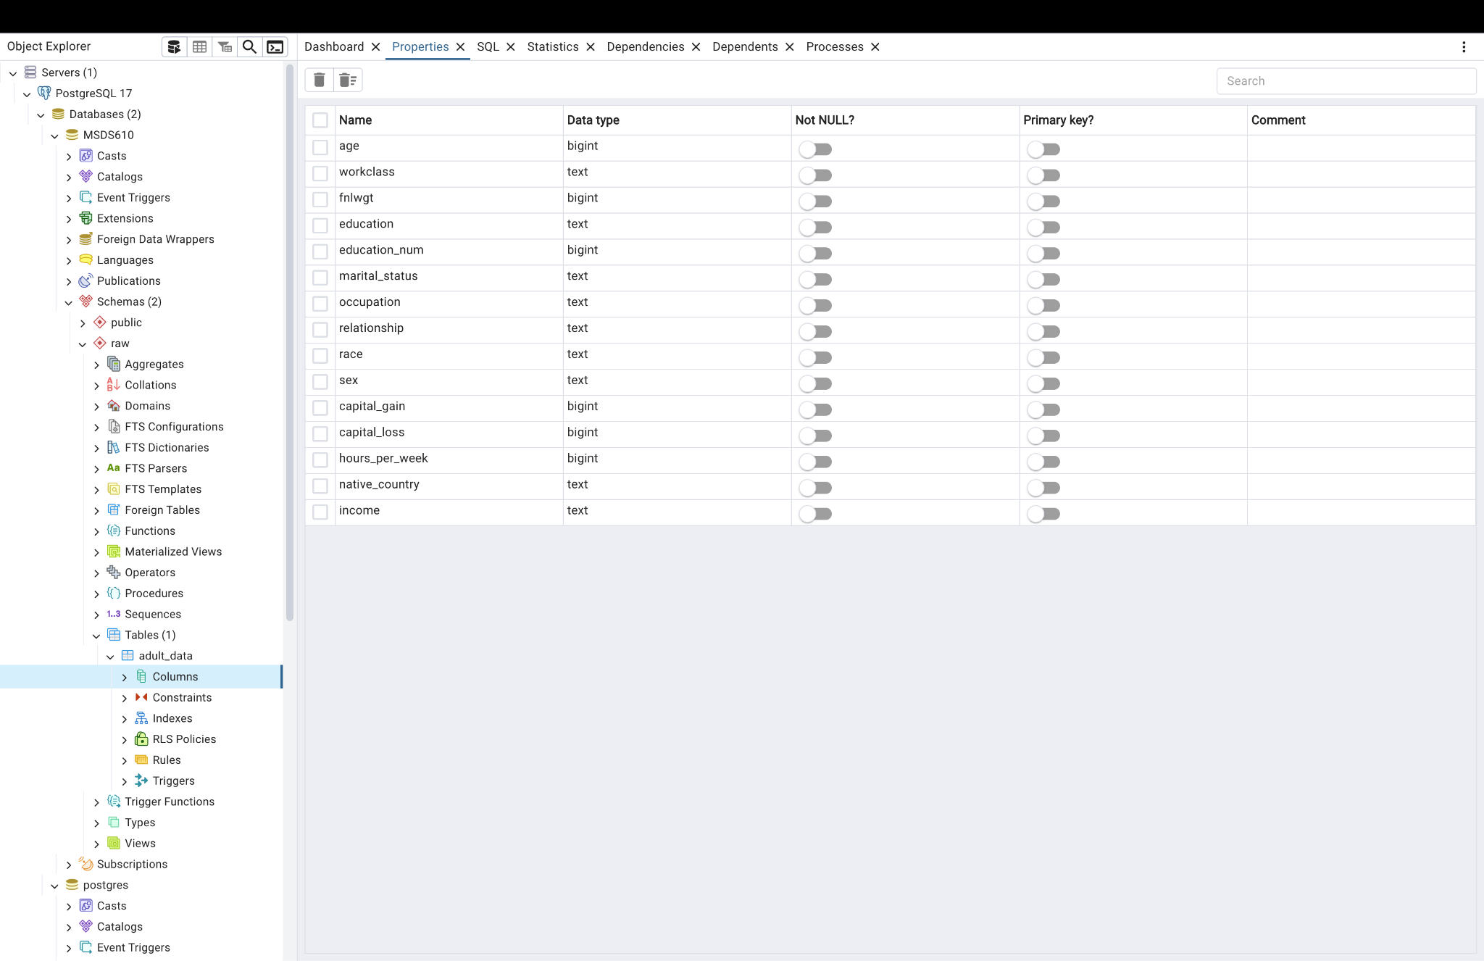
Screenshot

Slide 10
Thank you

